Slide 1
Freezing Occurrence in Mangrove Distribution Regions Under Climate Scenarios.
By Kesse Asante

Slide 2
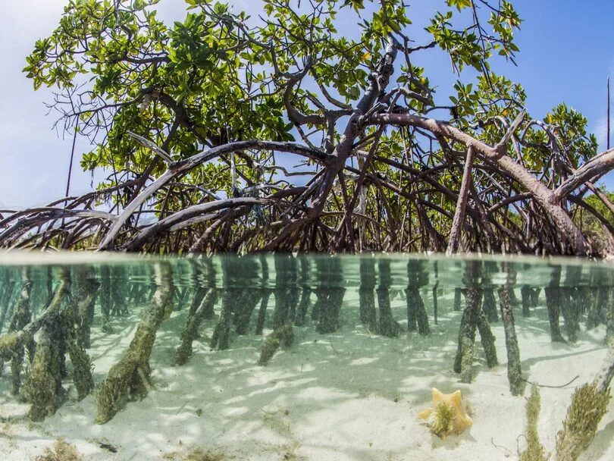
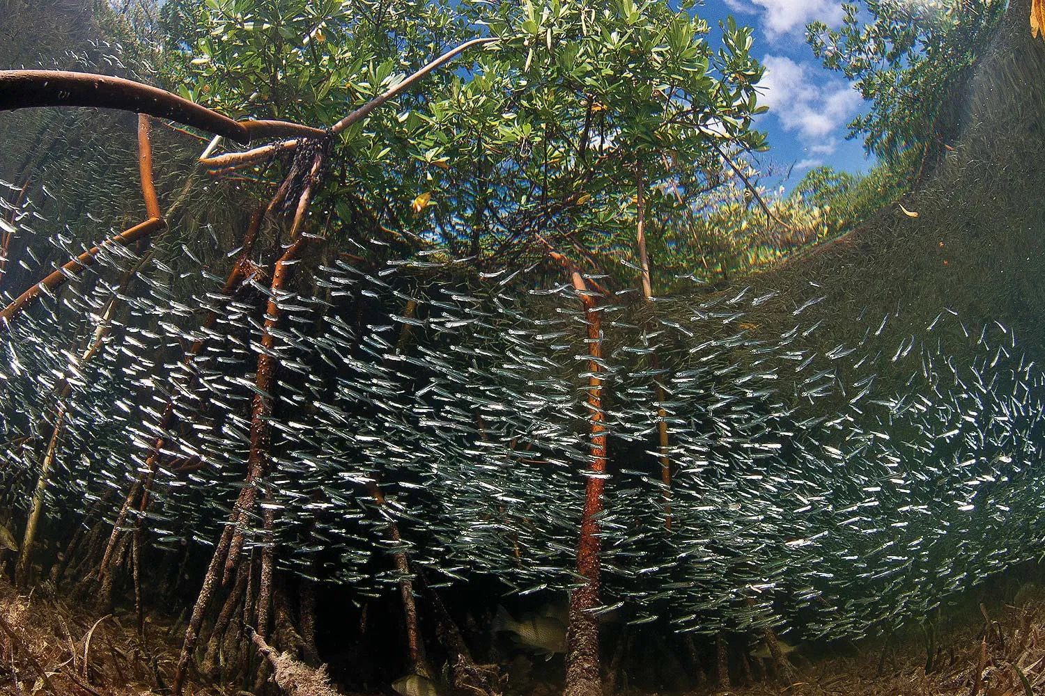

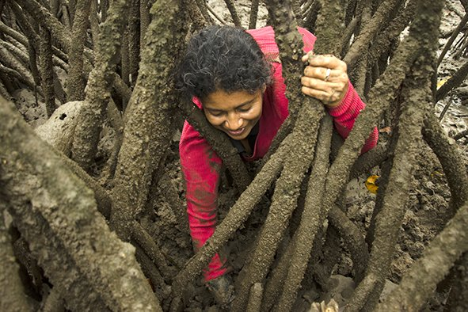
Why Mangroves?

Slide 3

Introduction
Mangrove ecosystems are critical to biodiversity and provide vital ecosystem services, including serving as nursing grounds for fishes, coastal protection and carbon sequestration.
Mangrove forests along the world’s coastlines hold ~ 3 billion metric tons of carbon - more than tropical forests (Friess et al., 2022).
Understanding the changes in mangroves extent has become increasingly significant due to this carbon storage and sequestration capacity.
Mangrove distribution is largely restricted to tropical and subtropical regions due to their sensitivity to freezing temperatures.

Slide 4
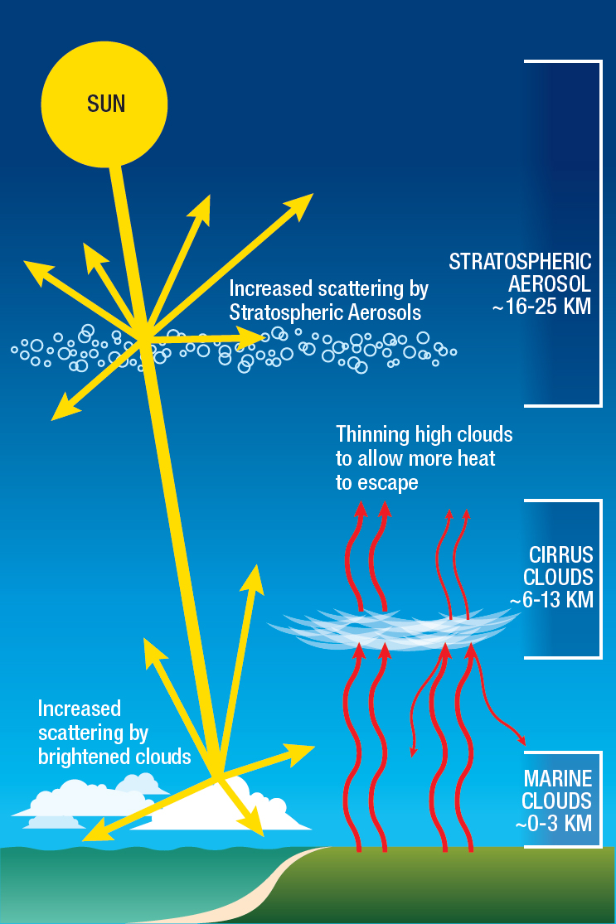
Shared Socioeconomic Pathways
Investigate how population growth, economic development, and technological advancements, interact with climate change (Meinshausen et al., 2020).
SSP2-4.5 (middle-of-the-road)
Greenhouse gas (GHG) emissions stabilize by mid-century and gradually decline.
Radiative forcing reaches 4.5 W/m² by 2100.
Stratospheric Aerosol Injection (SAI)
Involves adding small liquid or solid particles to the stratosphere to reflect sunlight and reduce global warming (Zarnetske et al., 2021).
Assessing Responses and Impacts of Solar climate intervention on the Earth system (ARISE-SAI): provide a foundation for understanding how such interventions might influence the Earth’s climate system.
Solar Radiation Modification Methods
(NASEM, 2021)

Slide 5
What does this mean for mangrove distributions?

Slide 6
Method
3. Coastal Mask Creation
7. Ensemble Member Simulations
1. Identification of Ecological Threshold
2. Climate Data Preparation
4. Mangrove Temperature Analysis
6. Integration of Geospatial Data
5. Scenario-Based Modeling

Slide 7
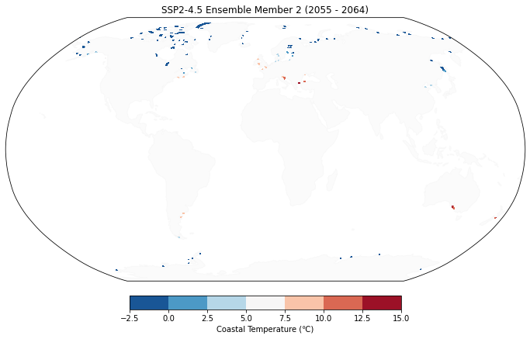
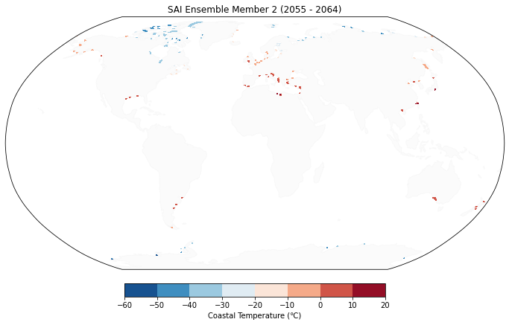
Results
Climate Scenario Comparison
No Intervention
Intervention
Figure 1: Freezing temperature regions under no intervention (SSP 2-4.5) and Intervention (SAI)

Slide 8
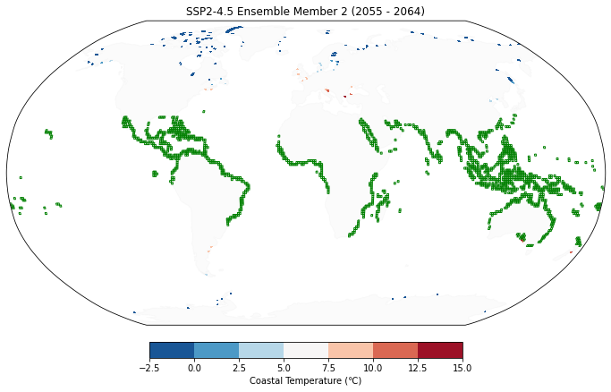
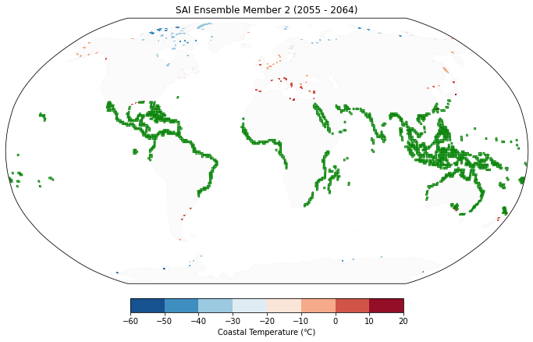
Climate Scenario Comparison
No Intervention
Intervention
Figure 2: Freezing temperature regions under no intervention (SSP 2-4.5) and Intervention (SAI) with global mangroves distribution (green)

Slide 9
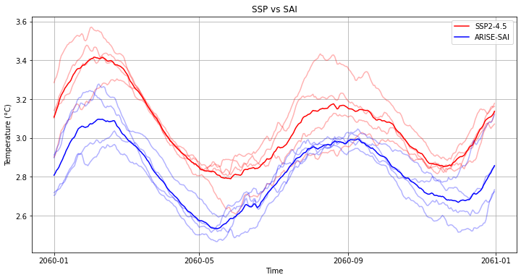
Temporal Trends
Figure 3: Comparison of minimum daily coastal temperatures between SSP2-4.5 and ARISE-SAI ensembles and ensemble mean over time.

Slide 10
Discussion
The cooling effects of SAI, while beneficial for mitigating global warming, could limit the adaptive capacity of mangroves to expand their range in response to moderate warming.
SSP2-4.5 offers conditions that could favor mangrove growth and expansion due to the reduced frequency of freezing temperatures in subtropical and tropical regions (Cooley et al., 2023).
By comparing SSP2-4.5 and ARISE-SAI, this study provides valuable insights into how different climate trajectories could shape the future of mangrove ecosystems.
These findings could contribute to the growing body of literature assessing the ecological consequences of climate change and intervention strategies, with implications for both policy and conservation planning.

Slide 11
References
Bunting, P., Rosenqvist, A., Hilarides, L., Lucas, R. M., Thomas, N., Tadono, T.,Worthington, T. A., Spalding, M., Murray, N. J., & Rebelo, L.-M. (2022). GlobalnMangrove Extent Change 1996–2020: Global Mangrove Watch Version 3.0. Remote Sensing, 14(15), 3657. https://doi.org/10.3390/rs14153657
Cavanaugh, K. C., Kellner, J. R., Forde, A. J., Gruner, D. S., Parker, J. D., Rodriguez, W., & Feller, I. C. (2014). Poleward expansion of mangroves is a threshold response to decreased frequency of extreme cold events. Proceedings of the National Academy of Sciences, 111(2), 723–727. https://doi.org/10.1073/pnas.1315800111
Cooley, S., Schoeman, D., Bopp, L., Boyd, P., Donner, S., Ito, S. i, Kiessling, W., Martinetto, P., Ojea, E., Racault, M. F., Rost, B., Skern-Mauritzen, M., Ghebrehiwet, D. Y., Bell, J. D., Blanchard, J., Cheung, W. W., Bolin, J., Dupont, S., Cisneros-Montemayor, A., Simmons, C. T. (2023). Oceans and Coastal Ecosystems and Their Services. Cambridge University Press. https://digital.csic.es/handle/10261/350582

